Slide 1
DS
Standard Template Library: Associative Containers

Slide 2
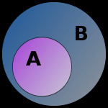
So Far ...
We’ve looked at
a subset of the STL
Notes:
http://upload.wikimedia.org/wikipedia/commons/thumb/b/b0/Venn_A_subset_B.svg/150px-Venn_A_subset_B.svg.png

Slide 3

The vector, deque, and list templates are what are called “sequence containers”
Notes:
http://www.inspiremonkey.com/wp-content/uploads/2010/06/action-pitching-sequence.jpg

Slide 4

Sequence Containers
The order of the elements is mostly related to when they were inserted into the container
Notes:
http://www.smart-kit.com/wp-content/uploads/2011/10/bucket-brain-teaser.jpg

Slide 5
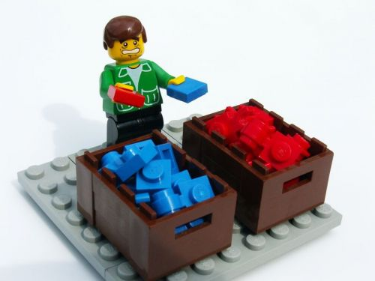
Associative Containers
Associative containers are sorted according to the characteristics of the items contained within them
Example: storing words, sorted alphabetically
Notes:
http://blog.pagerduty.com/wp-content/uploads/sorting-lego.jpg

Slide 6
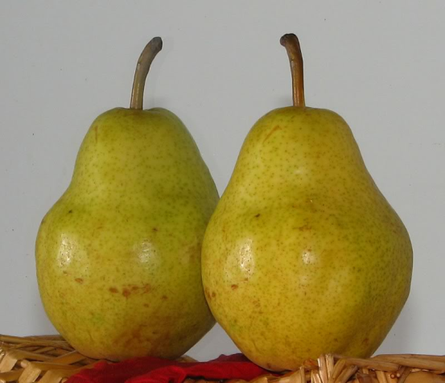
Before We Start ...
We have to cover another template before we start associative containers: the pair template
Notes:
http://i44.photobucket.com/albums/f31/Edd_S/pair_1.jpg

Slide 7


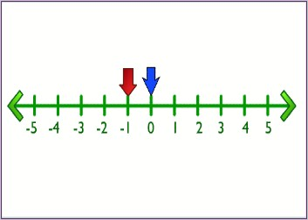
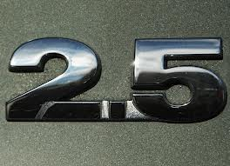
Pairs
The pair template is used to contain two items
e.g. pair<int, float> p;
This pair contains an int and a float
Notes:
http://www.linux-support.com/cms/wp-content/uploads/2012/04/ghostbsd-2.5.jpg
http://adoptanegotiator.org/wp-content/uploads/2012/11/0.5.jpg
http://1.bp.blogspot.com/-6wndQyn5nY8/T2DJLw35oBI/AAAAAAAACgo/jQHHWEEs4Mw/s1600/PiPoster.jpg

Slide 8


There are two fields associated with a pair: first and second
Notes:
http://www.awardstudio.com/webdocs/photos/XR-282_SECOND_PLACE1.jpg
http://www.thepigbarbq.com/_img/blue-ribbons.gif

Slide 9
first ‘s data type will be of the first template parameter
e.g. int in the preceding example

Slide 10

second ‘s data type will be of the second template parameter
e.g. float in the preceding example

Slide 11

pair Comparison
Two pairs are equal if both values are equal
Notes:
http://2.bp.blogspot.com/-nb0t3veX4ls/UEqBy50tnNI/AAAAAAAAFds/Ae80JcqOzs8/s1600/equality2.gif

Slide 12

If two pairs are unequal, the individual values are compared (first against first), with the first fields being of higher priority
Notes:
http://www.k-international.com/blog/wp-content/uploads/2011/08/Higher-Priority.jpg

Slide 13

make_pair()
There is a function provided for convenience to create pairs easily: make_pair()
Notes:
http://rlv.zcache.com/valentine_we_make_a_great_pair_dice_card-p137512765384285502b21fb_400.jpg

Slide 14
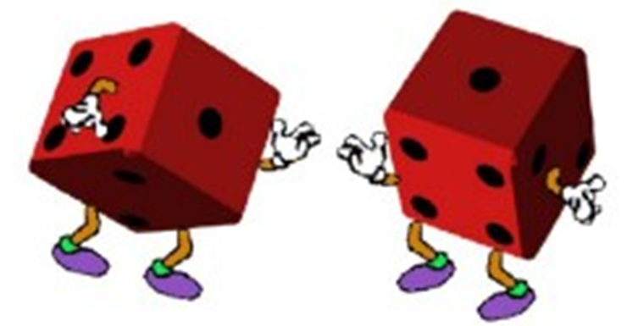
e.g. make_pair(4, “fred”) will create a pair where first will be 4 and second will be “fred”
Notes:
http://rlv.zcache.com/valentine_we_make_a_great_pair_dice_card-p137512765384285502b21fb_400.jpg

Slide 15

It’s important to make sure that the data types for the two parameters are unambiguous, since you might end up with a different result than you want
Notes:
http://bluejayblog.files.wordpress.com/2011/07/ambiguous-visual02.jpg

Slide 16

Why are pairs useful in the STL?
Two reasons:
It makes it possible to easily return two items from a function.
Notes:
http://pubpages.unh.edu/~cam486/project/return.gif

Slide 17
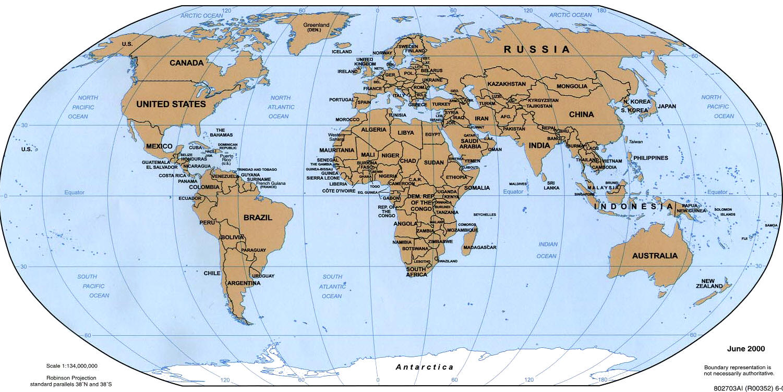
2. It allows you to pair up related data for storage in a container like a map.
Notes:
http://2.bp.blogspot.com/-197A-xFOkLY/Tb6G9Z6mgII/AAAAAAAAC4c/K_KinLzbIZ8/s1600/world+map_only_pic.jpg

Slide 18

We’ll look at the application of the first reason first in the context of a set

Slide 19
Another STL Template: Set
A set contains unique values that are sorted by the values themselves

Slide 20

Duplicates are not allowed
Notes:
http://4.bp.blogspot.com/_9GkJR8zHmCk/SN7AcmphceI/AAAAAAAAATY/MFftw5apzJE/S240/600PX-~1%5B1%5D.jpg

Slide 21

You need to have some way of comparing the items to allow for the sorting
Notes:
http://www.roammobility.com/media/wysiwyg/D1/apples-to-oranges.jpg

Slide 22

Less Randomness
The set is far more rigid than the other containers we’ve seen so far:
You can’t randomly access the items
You can’t directly change the items
Notes:
http://www.dogsandbabieslearning.com/wp-content/uploads/2011/05/no.jpg

Slide 23

What? You can’t change the items???
You can’t directly change the items (due to the way that it's usually implemented)
Notes:
http://lifeinsurancebyjeff.com/wp-content/uploads/2012/12/direct-term-life-insurance.jpg

Slide 24


To change a value in a set:
delete the old element, and then
insert the newly changed value
Notes:
http://upload.wikimedia.org/wikipedia/commons/2/2c/Key_delete.jpg
http://www.wpclipart.com/computer/keyboard_keys/special_keys/computer_key_Insert.png

Slide 25

Value Comparisons
You must be able to compare the items you are storing in the set
The default comparison is less
Notes:
http://mathsticks.com/userfiles/isLessThanImg.jpg

Slide 26
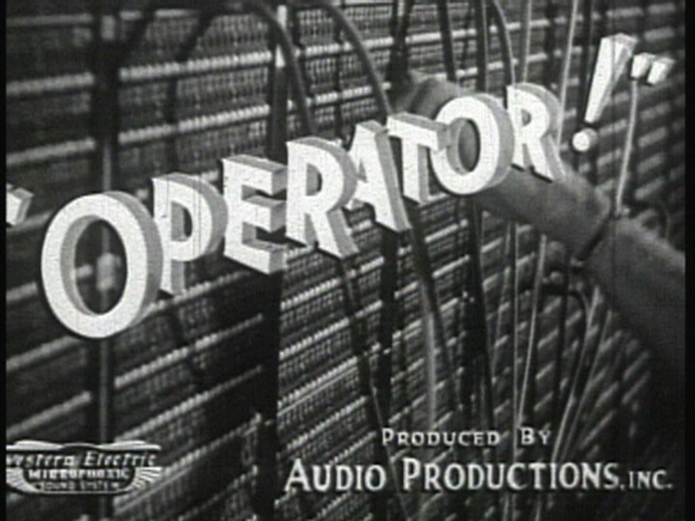
If you are storing primitive data types, less already exists
If you are storing classes, operator< must exist as an overloaded operator
Notes:
http://artifactproductions.ca/fantome/stills/A-2_Film-title_Operator.jpg

Slide 27
Instantiating a set
e.g. set<MyClass> coll; is a set of MyClass called coll
It sorts using operator<, which would need to be overloaded for MyClass

Slide 28

Inserting using the insert() Method
The easiest way to insert an element into the set is to use insert(e), where e is an object of the appropriate data type

Slide 29

If the object to be inserted is already in the set, the insertion will fail
Why? All elements of the set must be unique!
Notes:
http://mishfish13.com/wp-content/uploads/2013/01/unique.jpeg

Slide 30

Return Value from insert(e)
The return value from insert(e) returns a pair
Why?
It is desirable to return an iterator so you can tell where the item you just inserted is
It is also desirable to know whether the insertion succeeded or not
Notes:
http://marshallmashup.usc.edu/wp-content/uploads/2013/02/success.jpg

Slide 31

In the pair, the first field contains an iterator and the second field contains the status as a bool (true or false)
Checking to see if the insertion succeeded:
e.g. if( c.insert(3.3).second == true )
Notes:
http://couponlove.files.wordpress.com/2011/01/yay.jpg

Slide 32
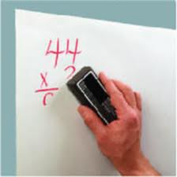
Deleting a Single Item from the Set
Use erase(e) or erase(iter)
e would be a value already in the list
iter would be an iterator
Notes:
http://www.mygowrite.com/images/SampleErase.jpg

Slide 33

It returns the number of items erased (0 or 1)
Unlike other STL methods, it is not called remove()
Notes:
http://www.waveformrecords.com/images/z1_350.jpg

Slide 34

Deleting Everything From A Set
Use clear()
Notes:
http://1.bp.blogspot.com/_FOIrYyQawGI/SjGW4Lkl9yI/AAAAAAAABvs/m6Ytr5iXnaQ/s1600/ClearWater.jpg

Slide 35

Something About set Iterators
All values “pointed to” by set iterators are const
You can dereference the iterator but don’t try to change the value
Notes:
http://farm5.staticflickr.com/4091/5015755974_f57744dfe4_z.jpg

Slide 36

OK, Why Use a set?
It’s optimized for fast searching
Notes:
http://media1.santabanta.com/full1/Hollywood%20Movies/Fast%20and%20Furious%206/fast-and-furious-6-0a.jpg

Slide 37
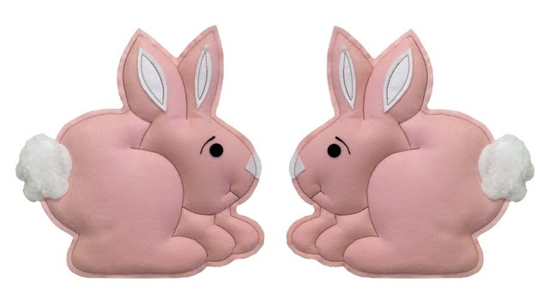
But what if you want duplicate values in your set???
Notes:
https://www.babyscorner.ca/images/7112%20Bunny%20Twins%20pink%20copy2.jpg

Slide 38
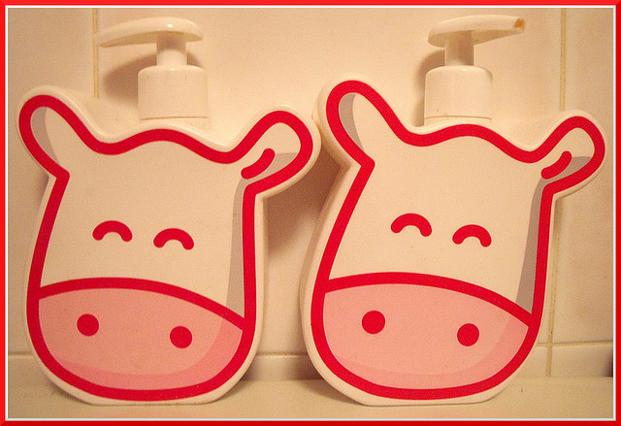
Multiset
Multiset: a set + you can have duplicate values
Notes:
http://farm4.staticflickr.com/3264/3196465164_132ff07a3d_z.jpg

Slide 39


Useful set and multiset Methods
find(elem) returns an iterator to the first element with value elem or it returns end()
count(elem) returns the number of elements that equal elem
Notes:
http://phoenix.wearenetwork.com/images2/find.jpg
http://retailmavens.com/images/CountVonCount.jpg

Slide 40
lower_bound(elem) returns an iterator to the first element that doesn’t go after elem
e.g. {10, 20, 30, 40, 50}
has a lower_bound(30) of
an iterator pointing to 30

Slide 41
upper_bound(elem) returns an iterator to the first element whose key is greater than elem
e.g. {10, 20, 30, 40, 50}
has an upper_bound(30) of
an iterator pointing to 40

Slide 42
equal_range(elem) returns a pair of iterators that contain lower_bound(elem) and upper_bound(elem)

Slide 43
set vs. multiset
Implications of multiset:
count(elem) can now return a number greater than 1
insert(elem) will not fail because of duplicates

Slide 44
erase(elem) will erase all items with the same value as elem but erase(iter) will only erase one item

Slide 45
set Example
set<char> grades;
grades.insert('A'); grades.insert('C');
grades.insert('D'); grades.insert('C');
grades.insert('F'); grades.insert('D');
grades.insert('B'); grades.insert('I');
display(grades);
cout << grades.count('D') << endl;
Output
A B C D F I
1

Slide 46
multiset Example
multiset<char> grades;
grades.insert('A'); grades.insert('C');
grades.insert('D'); grades.insert('C');
grades.insert('F'); grades.insert('D');
grades.insert('B'); grades.insert('I');
display(grades);
cout << grades.count('D') << endl;
Output
A B C C D D F I
2

Slide 47

Pointers and Uniqueness
Don’t store pointers in sets unless you really know what you’re doing!
Notes:
http://sparkplug9.com/wp-content/uploads/2012/04/genius.gif

Slide 48
e.g.:
set<string*> ss;
ss.insert(new string("glort"));
ss.insert(new string("glort"));
cout << ss.size() << endl; // outputs 2!

Slide 49

Why? The values stored are numbers representing the addresses!
Notes:
http://dogbreedsites.com/wp-content/uploads/2012/01/German-Shorthaired-Pointer-puppies-4.jpg

Slide 50
Another Associative Container
What if we want to keep track of pairings of data?

Slide 51

Map
A map is an STL container that contains key / value pairs, sorted by the key

Slide 52

maps do not allow duplicates
Notes:
http://starrforce.com/wp-content/uploads/2012/05/True-Internal-Duplicate-Content1.jpg

Slide 53

Just like set and multiset, there is a multimap to go along with the map container
Most characteristics of maps also apply to multimaps

Slide 54

Instantiating a map
e.g. map<int, string> m;
the first parameter is the key
the second parameter is the value that goes along with the key
Notes:
http://www.thewritingnut.com/wp-content/uploads/2011/04/key-737977.jpg

Slide 55



the map is sorted only by the keys, not by the values
Notes:
http://www.clker.com/cliparts/7/1/d/3/119498577810047030key_juliane_krug_01.svg.med.png
http://2.bp.blogspot.com/-ptV_fwVHrgM/TrcsYPp98NI/AAAAAAAAAig/hGOHmeIIK1w/s1600/Key_to_the_City_of_London%25252C_Charles_Lindbergh.JPG
http://www.acecars-stives.co.uk/KEY.png
http://www.thewritingnut.com/wp-content/uploads/2011/04/key-737977.jpg

Slide 56
Specifying a Comparator
Again, you can explicitly specify a comparitor (default is less)
once you understand
about
overloaded operators

Slide 57

Performance
Searching for the key is
usually fast
Notes:
http://www.inc.com/uploaded_files/image/speed_950x633_21177.jpg

Slide 58
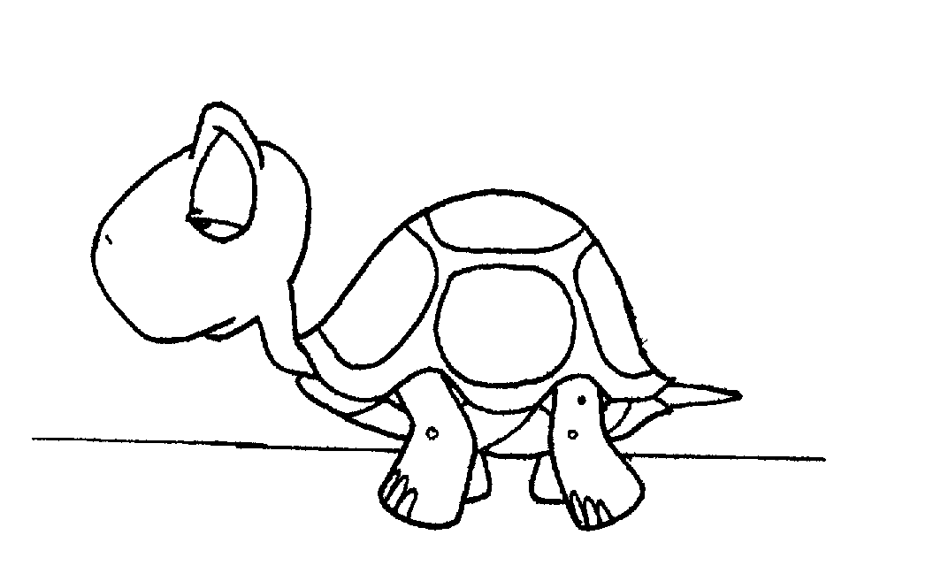
Searching for a value without using the key is usually sssslllllloooowwww
Notes:
http://www.registrycleanerz.com/wp-content/uploads/articles/original/slow.gif

Slide 59
Changing Keys?
You can’t change a key directly (same reasoning as with sets)

Slide 60

You can change a value associated with a key
Reason: It won’t affect the order of the map
Notes:
http://upload.wikimedia.org/wikipedia/fi/archive/8/88/20081004233614!Changesonebowie.jpg

Slide 61
Methods
Many of the same methods that are found in sets are found in maps and multimaps
One major difference: find() only searches for keys, not values associated with keys

Slide 62
Example of Finding Elements with a Certain Value
multimap<string, float> coll;
multimap<string, float>::iterator pos;
for( pos = coll.begin(); pos != coll.end(); ++pos)
{
if( pos->second == value )
do_something();
}

Slide 63
map Methods
m.insert(make_pair(key, value)); // inserts
m.count(key); // times occurs (0, 1)
m.erase(key); // removes it

Slide 64
Multimap example
Output:
314
430
345
multimap<string, int> mm;
mm.insert(make_pair("barney", 102));
mm.insert(make_pair("fred", 314));
mm.insert(make_pair("fred", 430));
mm.insert(make_pair("fred", 345));
mm.insert(make_pair("barney", 101));
multimap<string, int>::iterator i = mm.find("fred");
if (i != mm.end()) // we found some freds
do
{ cout << i->second << endl;
++i;
} while (i != mm.upper_bound("fred"));

Slide 65
Multimap example (continued)
// display all; could use display(mm)!
for (i = mm.begin(); i != mm.end(); )
{
const multimap<string, int>::iterator j = mm.upper_bound(i->first);
cout << i->first<<' ' << mm.count(i->first)
<< ": ";
do
{
cout << i->second << " ";
++i;
} while(i != j && i != mm.end());
cout << endl;
}
Output:
barney 2: 102 101
fred 3: 314 430 345

Slide 66
set Example (Using multimap)
set<string> ss;
for (multimap<string, int>::iterator i = mm.begin(); i != mm.end(); ++i)
ss.insert(i->first);
display(ss);
display(mm);
barney fred
(barney, 102) (barney, 101) (fred, 314) (fred, 430) (fred, 345)

Slide 67
Classes in Associative Containers
Can put your classes in associative containers
under two conditions

Slide 68
1) Must have a default (no parameter) constructor

Slide 69
2) Must have be able to do a comparison (using < or something else)

Slide 70
Associative Container Summary
map: 1:1, sorted, m[k] = v
multimap: 1:n, sorted, mm.insert(make_pair(k,v))
set: unique elements, sorted
multiset: multiple keys allowed, sorted

Slide 71
Reminder
There is a lot more to these containers than what you are learning here
e.g. There are 5 different insert() methods

